Slide 1

Model Evaluation
5
Test-driven Machine Learning

Slide 2
5.1
Evaluation and Validation.

Slide 3
Why do we need to evaluate models?
To avoid overfitting/underfitting
To ensure a model’s prediction are reliable
To evaluate how a model may work in real-world scenarios
Aid engineers to make decisions about model deployment
5.1. Evaluation and Validation

Slide 4
How do we evaluate models?
Any evaluation we make has to be an objective one
There are several metrics to evaluate a model, for example:
Accuracy
Precision
Recall
F1-Score
5.1. Evaluation and Validation

Slide 5
5.2
Overfitting / Underfitting.

Slide 6
Understanding Overfitting
Overfitting is when model memorizes training data
This is the opposite of learning a pattern and generalizing
We can identify if our model is overfitted if:
There is high performance on training data
There is poor performance on test data
5.2. Overfitting / Underfitting.

Slide 7
Understanding Underfitting
Underfitting happens when the model is too simple
The underlying data patterns have not been captured
We can identify if our model has underfitting if:
Low performance on training data
Low performance on test data
5.2. Overfitting / Underfitting.

Slide 8
The Perfect Fit
A perfect fit can be achieved
By first constructing good evaluation metrics to give us feedback on model performance
Then tuning hyper-parameters till the performance improves across the board
5.2. Overfitting / Underfitting.

Slide 9
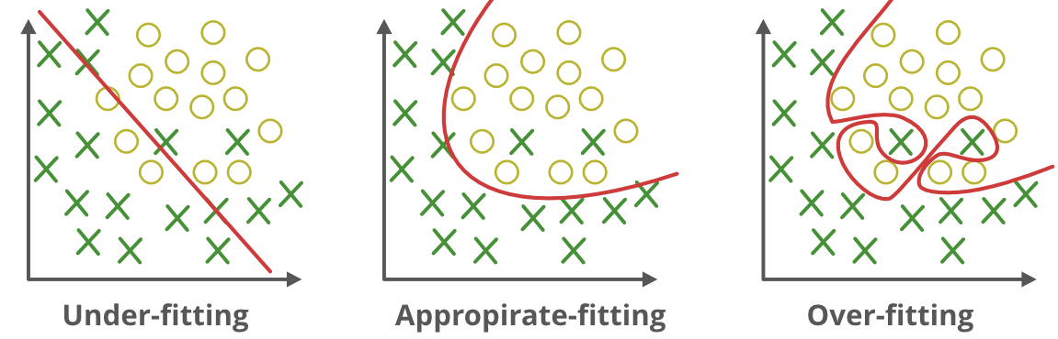
5.2. Overfitting / Underfitting.

Slide 10
5.3
Classification
Performance Metrics.

Slide 11
Accuracy
Accuracy is calculated by dividing the total correct predictions with the total number of predictions
Ideal Usage
When class distributions are balanced
Ex: Determining the winner in a sports match
# Python Implementation
from sklearn.metrics import accuracy_score
accuracy = accuracy_score(y_true, y_pred)
5.3. Classification Performance Metrics

Slide 12
Precision
Precision counts the true positives out of all the items predicted to be positive
Ideal Usage
When the cost of false positive is too high
Ex: Email spam detection
# Python Implementation
from sklearn.metrics import precision_score
precision = precision_score(y_true, y_pred)
5.3. Classification Performance Metrics

Slide 13
Recall
Recall counts how many of the true positive items were correctly classified
Ideal Usage
When the missing a positive is too costly
Ex: Disease diagnosis
# Python Implementation
from sklearn.metrics import recall_score
recall = recall_score(y_true, y_pred)
5.3. Classification Performance Metrics

Slide 14
F1-Score
The average of precision and recall
Ideal Usage
When a balance between precision and recall is required, especially when there is class imbalance
Ex: Content Moderation System
# Python Implementation
from sklearn.metrics import f1_score
f1 = f1_score(y_true, y_pred)
5.3. Classification Performance Metrics

Slide 15
Python Implementation
from sklearn.linear_model import LogisticRegression
from sklearn.datasets import load_breast_cancer
# Load a sample dataset
X, y = load_breast_cancer(return_X_y=True)
X_train, X_test, y_train, y_test = train_test_split(X, y, test_size=0.2)
# Train the model
clf = LogisticRegression(max_iter=5000)
clf.fit(X_train, y_train)
# Make predictions on test data
predictions = clf.predict(X_test)
4.2. Statistical Machine Learning.
4.2. Linear Regression.

Slide 16
5.4
Regression
Performance Metrics.

Slide 17
Mean Absolute Error (MAE)
The average of the absolute differences between the predicted values and actual values
Ideal Usage: When you want to understand the magnitude of error without regard to direction, especially in contexts where large errors aren't more significant than small ones
# Python Implementation
from sklearn.metrics import mean_absolute_error
mae = mean_absolute_error(y_true, y_pred)
5.4. Regression Performance Metrics

Slide 18
Mean Squared Error (MAE)
The average of the squared differences between the predicted values and actual values
Ideal Usage: When larger errors are particularly undesirable and should be penalized more. Such as stock market predictions
# Python Implementation
from sklearn.metrics import mean_squared_error
mse = mean_squared_error(y_true, y_pred)
5.4. Regression Performance Metrics

Slide 19
Root Mean Squared Error (RMSE)
The square root of MSE, offering error magnitude in the same units as the predicted values
Ideal Usage: When you want to interpret the error in the original unit and penalize larger errors. Such as predicting the price of houses
# Python Implementation
import numpy as np
rmse = np.sqrt(mse) # assuming mse is already calculated
5.4. Regression Performance Metrics

Slide 20
R-squared (Coefficient of Determination)
Represents the proportion of variance for the dependent variable that's explained by independent variables
Ideal Usage: When you want to understand the proportion of the dataset's variability captured by the model. Such as how much variance in exam scores are explained by hours studied
# Python Implementation
from sklearn.metrics import r2_score
r2 = r2_score(y_true, y_pred)
5.4. Regression Performance Metrics

Slide 21
Adjusted R-squared
Modifies R-squared to account for the number of predictors in the model, penalizing excessive use of features
Example: Predicting a car's fuel efficiency based on its attributes. Using too many irrelevant attributes might inflate R-squared, but adjusted R-squared will provide a more tempered view
n = len(y_true) # number of samples
p = X.shape[1] # number of predictors/features
adjusted_r2 = 1 - (1 - r2) * (n - 1) / (n - p - 1) # assuming r2 is calculated from the previous slide
5.4. Regression Performance Metrics

Slide 22
Mean Bias Deviation (MBD)
The average difference between the predicted and actual values, indicating the direction of the error
Ideal Usage: When you're interested in the direction of the error (overestimation vs. underestimation). Helps vary it over or under the limits set
# Python Implementation
mbd = np.mean((y_true - y_pred) / y_true) * 100 # Percentage error
5.4. Regression Performance Metrics

Slide 23
END.

